Slide 1
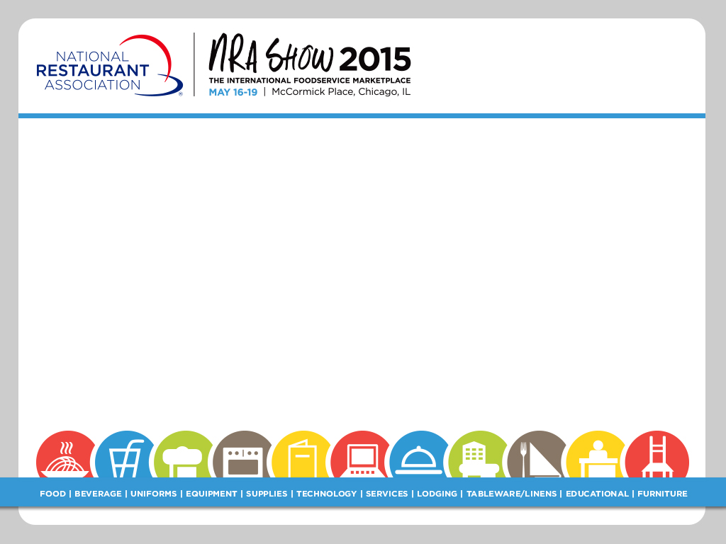
Vicarious Liability and “Joint Employer” Issues in Franchising May 2015
Presented by
Michael H. Seid and Lee Plave
May 19, 2015

Slide 2
Vicarious Liability
In franchising, when the franchisor is deemed responsible for something that the franchisee does or that takes place at the franchisee’s unit.
Examples
Slip-and-fall causing injury to plaintiff
Foodborne illness
Design defect
Criminal acts
Based on theory of “Actual Agency” or “Apparent Agency”
Actual Agency – the FR allegedly directed the act that caused injury to a third party
Apparent Agency – the injured party reasonably thought it was dealing directly with the FR, not a FE

Slide 3
Joint Employment
Holding party “A” responsible for the employment and labor relations activities of party “B”.
In the franchise context, allegations that a franchisor is responsible for its franchisees’ human resource policies due to excessive control over franchisees above that necessary to protect their intellectual property.

Slide 4
Joint Employment – The NLRB
The NLRB Matter
What is the “NLRB”
What has happened?
Complaints vs. McDonald’s USA LLC and numerous “McDs” FEs
First hearing – NYC; Mar. 30, 2015
Amicus Brief in Browning Ferris case (June 2015)
Advice Memo in re “Freshii” (April 28, 2015)
What may happen?
NLRB Process
Legislative steps
Political steps

Slide 5
Joint Employment – The NLRB
Timeline and “Where Do We Go From Here”
2014: GC issued admin. complaints within the NLRB.
2015: Hearings before ALJs within the NLRB
201_: ALJs issue decisions
201_: Cases may be consolidated; appealed to full NLRB
201_: NLRB conducts a hearing and render a decision
201_: NLRB decision can be appealed
201_: U.S. Ct. Appeals for DC Circuit (3-judge panel); then
20__: possible appeal to DC Circuit (en banc); then
20__: possible appeal to U.S. Supreme Court

Slide 6
Joint Employment – The NLRB
GC amicus brief in Browning-Ferris (June 2015): Cites David Weil’s writing on “Fissured Workplaces” Weil heads US Dept. of Labor Wage & Hours Div.
[T]he putative joint employer wields sufficient influence over the working conditions of the other entity’s employees such that meaningful bargaining could not occur in its absence. | [O]ne entity is in a position to influence the labor relations policies of the other, such as outsourcing of functions integral to the employer’s business or franchising. Both types of work arrangements “alter who is the employer of record or make the worker-employer tie tenuous and far less transparent.”
GC stmt re McDonald’s on website (July 2015)

Slide 7
Joint Employment – The NLRB
What is there to work from?
June 2014 – three paras. in Browning Ferris
July 2014 – two para. statement on website
Oct. 2014 – remarks by Gen Counsel at W. Va. Law School (arguments vs. franchisors could face "a problem legally.“)
Considerable body of previous cases
March 2015 – McDonald’s hearings – but precious few facts
New!
May 12, 2015 – NLRB posts GC advice memo on Joint Employment case (In Re Freshii)

Slide 8
Joint Employment – The NLRB
Advice Memo in re Freshii, Apr. 28, 2015
FR gave advice on various matters but did not bind FE on labor and HR issues
FE could choose to do as it wished re labor and HR, and was exclusively responsible for employment matters
FR advice and guidance geared to brand stds
FR may have facilities collecting resumes, but just passed them on to FEs
FR didn’t provide scheduling S/W, get involved in wages, hiring, firing, etc.
GC’s Conclusion: FR not a Joint Employer under “old” or the GC’s proposed new std

Slide 9
Vicarious Liability – The Courts
Vicarious liability cases – courts carefully review facts
Patterson v. Domino’s Pizza, 333 P.3d 723 (Cal. Sup. Ct. 2014)
Singh v. 7-Eleven, Inc., 2007 WL 715488 (ND Cal. Mar. 8, 2007)
applied economic reality test; control of hrs., uniforms, service, deliveries, rt. to terminate, not enough to “interfere with day-to-day operations of the Store”
even control over payroll, time records, tax collection/ payment not enough to establish that FR was employer)
Hatcher v. Augustus, 956 F. Supp. 387 (E.D.N.Y. 1997) (FR didn’t operate, have hiring/firing power; FR not jt. employer)

Slide 10
Joint Employer – The Courts
Co-employment cases – courts may allow claim of “joint employer” status to survive motion to dismiss – in order to determine the facts
Cordova v SCCF Inc., 2014 WL 3512838 (S.D.N.Y. 2014)
Olvera v. Bareberger Group, 2014 WL 3388649 (S.D.N.Y. 2014)

Slide 11

A Call to Excellence
Are Disclaimers Enough?

Slide 12


A Call to Excellence
Training, Site Visits, and Manuals:
Effect on Joint Employment
and
Vicarious Liability?

Slide 13

A Call to Excellence
Training, Site Visits, and Manuals:
Effect on Joint Employment
and
Vicarious Liability?

Slide 14

Questions
Michael H. Seid Managing Director
MSA Worldwide 94 Mohegan Drive West Hartford, CT 06117 (860) 523-4257
mseid@msaworldwide.com
Lee J. Plave Co-Founding Partner
Plave Koch PLC
12005 Sunrise Valley Drive Suite 200
Reston, Virginia 20191
(703) 774-1203
lplave@plavekoch.com
@LJPlave

