Slide 1



March 24, 2016
Jonathan Litchman
The Providence Group
@JDLitchman
Dan Caprio
The Providence Group
@DWCaprio
Lee Plave
Plave Koch PLC
@LJPlave
International Franchise Association, 1900 K Street, NW Suite 700, Washington, DC 20006 @Franchising411

Slide 2

FTC v Wyndham Worldwide Corp.
Facts: 3 breaches in 2008-09
Network intrusions may have led to compromise of PII (here, payment card information)
All data involved was at hotel level
2010: FTC launches investigation
2012: FTC sues Wyndham, alleges unfair & deceptive acts arising from data security breaches

Slide 3
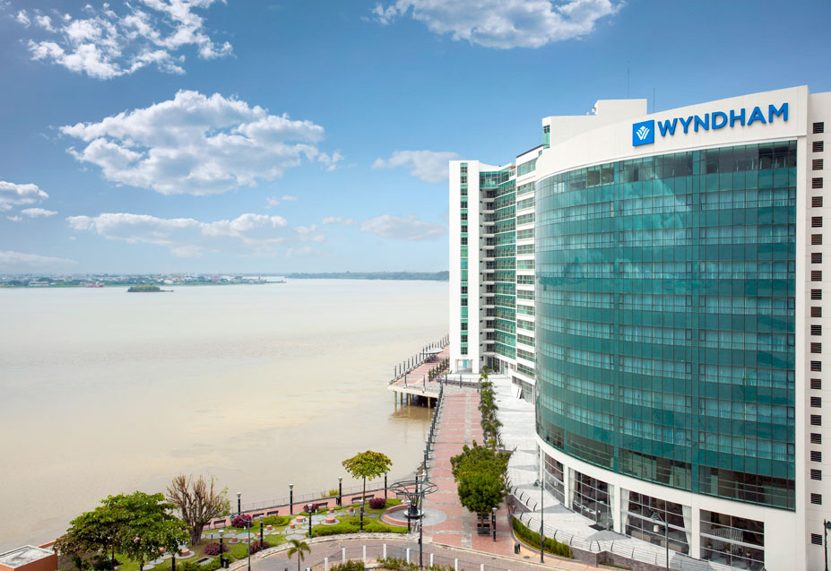
FTC v Wyndham Worldwide Corp.
Case heard by U.S. District Court
Interim appeal to U.S. Ct. Apps. for 3d Circuit
3d Cir. - FTC can proceed w case (Aug. 2015)
But – 3d Cir. clips FTC’s wings on theory of liability
FTC quickly settles w/ Wyndham (Dec. 2015)

Slide 4

FTC v Wyndham Worldwide Corp.
FTC Settlement
Info security required, but ltd. to PII cardholder data
Annual security assessments, ltd to cardholder data
Safe harbor if W. obtains PCI-DSS certification assessment
In practice, W. must treat FEs networks as “untrusted networks”
W. must protect itself from risks coming from FEs and 3d parties
But what would happen in another case, w diff. fact pattern?
Bad Facts Make Bad Law
Oliver Wendell Holmes

Slide 5
FTC v Wyndham Worldwide Corp.
PRACTICAL OPTIONS:
Either ❶ treat FEs as “untrusted networks” (same as other 3rd parties for purpose of putting protections in place) or ❷ as “controlled” networks (in which case FR may be directly responsible for what goes on at FE network level).
If FR provides security services to FEs that may tip the balance toward FTC taking action
WHY WOULD THERE BE A DIFFERENT OUTCOME?
Different facts, different outcome
Different enforcement body (e.g., state govts)
Private litigation

Slide 6
Where Do We Go From Here
FRs need resources for info security
FR network separate from FE networks
FEs also need professional assistance w info security
But not from the FR!
FR can mandate that FEs obtain third party svcs to secure their networks, comply with PCI-DSS
Goals: comply, protect consumers’ PII, protect employee PII, protect FR, protect BRAND, protect FEs’ equity
FR
FEs
Brand

Slide 7

Cybersecurity Roadmap
Protecting Cardholder Data
Risk Identification
Cyber Risk Assessment and Plan
Governance

Slide 8
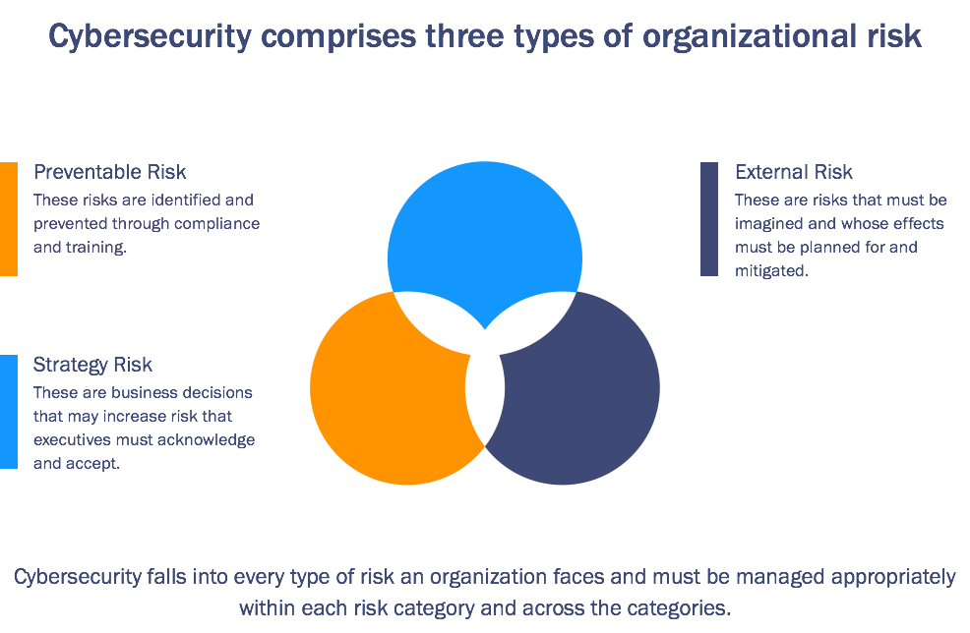
Cyber Risk in Context
©The Providence Group, LLC All Rights Reserved

Slide 9
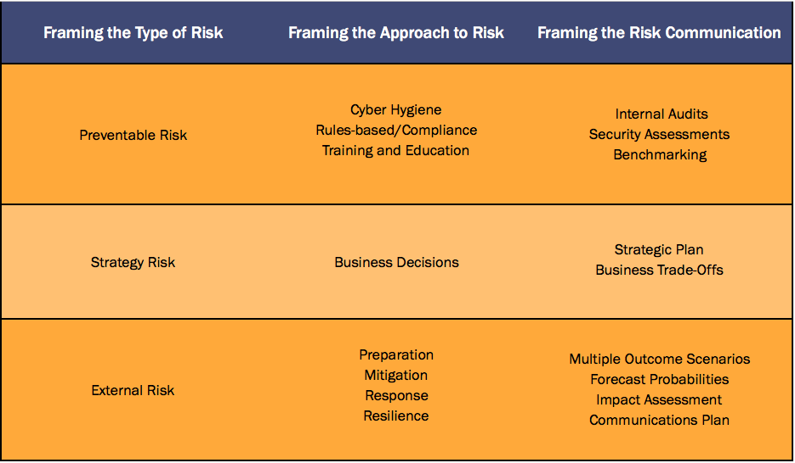
Framing Cyber Risk
©The Providence Group, LLC All Rights Reserved

Slide 10

Focus on PCI
Annual assessment under the Payment Card Industry standard
Independent third-party auditor
Not a check the box exercise
Importance of strategic plan as you map risk assessment under the PCI guidelines

Slide 11
Jonathan Litchman
The Providence Group
@JDLitchman
jlitchman@providencegroupdc.com
571.533.7755
Dan Caprio
The Providence Group
@DWCaprio
dcaprio@providencegroupdc.com
202.680.4538
QUESTIONS?
Lee Plave
Plave Koch PLC
@LJPlave
lplave@plavekoch.com
703.774.1203

